Slide 1
Nashville Takes on COVID
NGH Foundation, Health Literacy Media, & Neighborhood Health

Slide 2
What’s Our Goal?
It’s simple:
We seek to increase the number of Nashville residents age 12 and older who get vaccinated for COVID and wear masks to protect themselves, friends, and family.
2

Slide 3
What do we propose to do?
Working together with you, we will:
Put brief, well-produced content about COVID vaccines and masking in front of every Nashvillian this month;
Show Nashvillians exactly how we are lowering barriers to make vaccines accessible to everyone; and
Give out at least 10,000 re-usable masks.
3

Slide 4
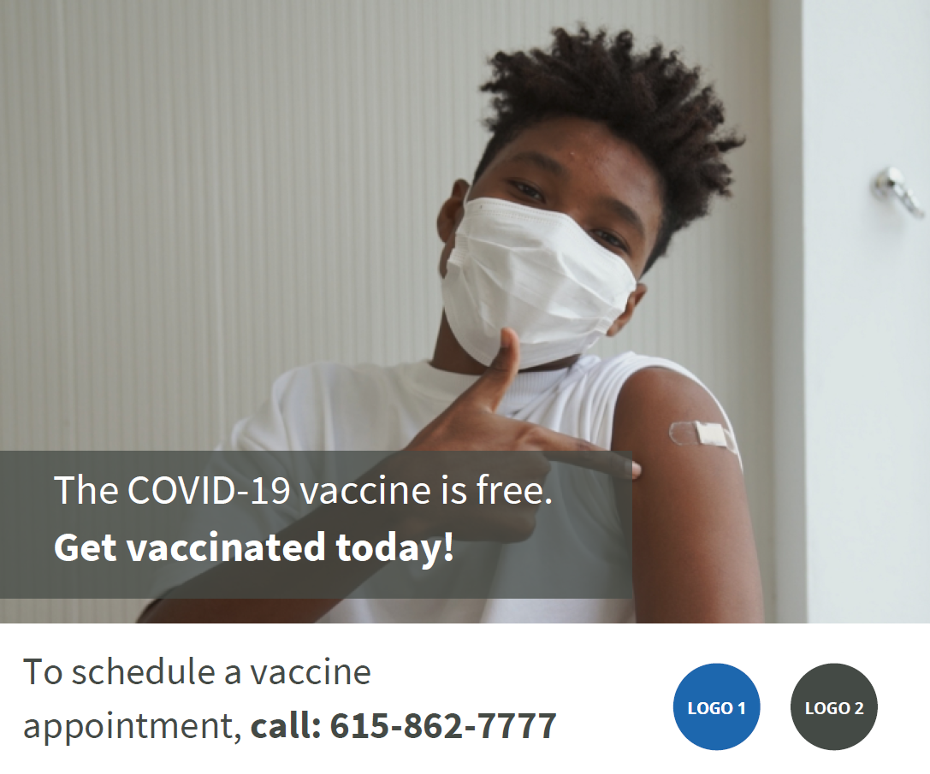
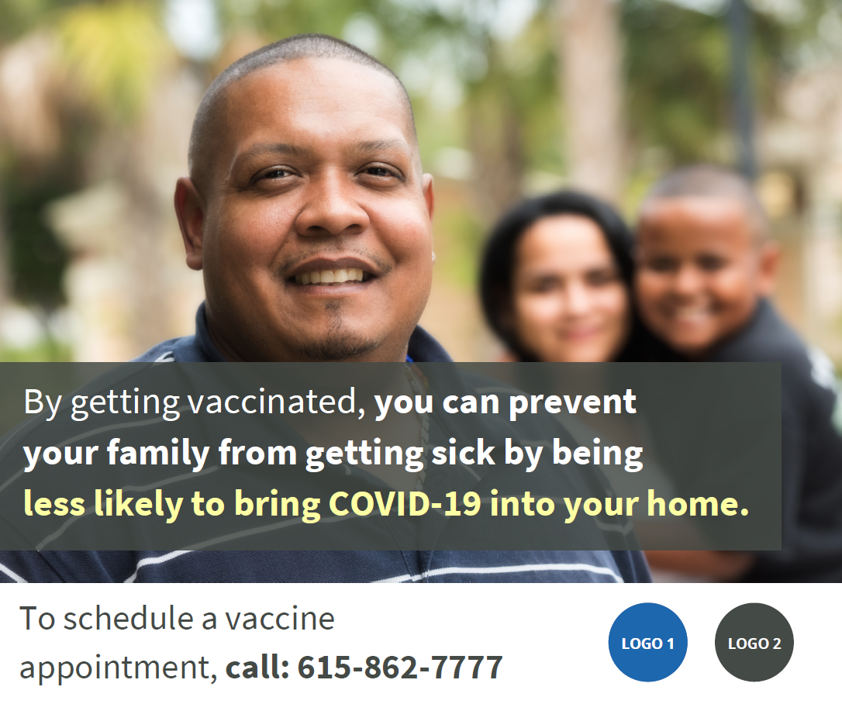
What do the posts look like?
4

Slide 5
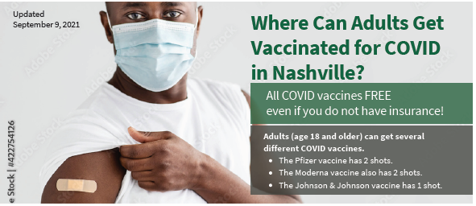
Flyer Sample
5

Slide 6
Why do we believe this can work?
Social media campaigns more likely to reach younger (and more unvaccinated) population.
If we all post the same content with the same #hashtags, the content will begin trending – and have outsized effect.
6

Slide 7
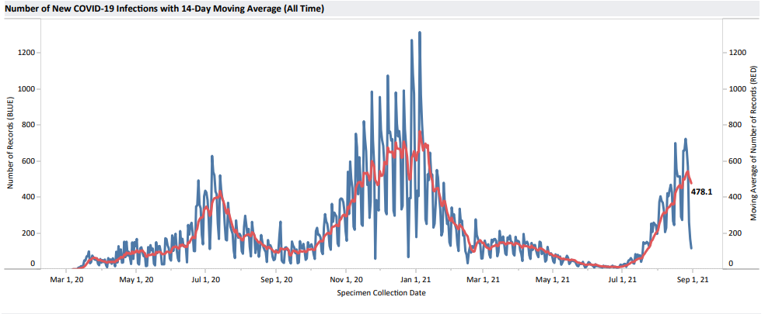
Why are we doing this now?
7

Slide 8
Why now? (cont’d)
(Older) groups with higher rates have had access longer.
We had hoped other age groups would “catch up.”
But that hasn’t happened as quickly as needed....
8

Slide 9
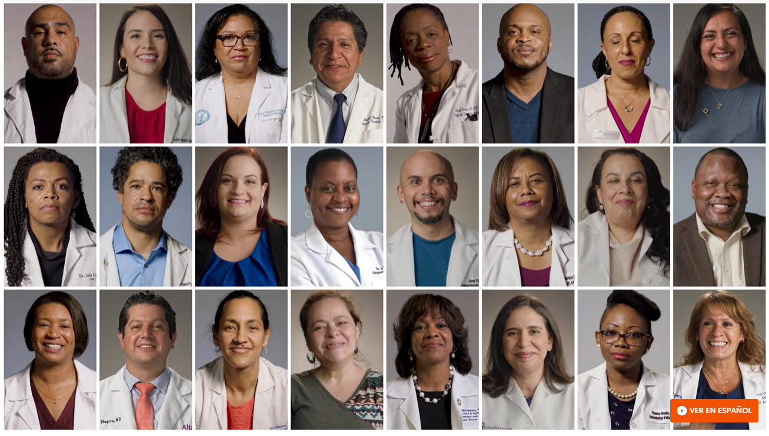
How do we fight myths/misinformation?
Simple: We don’t.
Rather, we post the video content in which medical professionals (largely persons of color) have recorded, and we let their words work.
9

Slide 10
What exactly is the “NToC” pledge?
You pledge to post brief videos on COVID vaccinations & masking on consistently during 28-day campaign.
You can also participate in other promotional activity.
The campaign will start Monday, Sept. 20th.
10

Slide 11
How do I sign up?
Sign the pledge at NashvilleTakesOnCovid.org
Email your logo to Vernon.Rose@NashvilleHA.org
Request posters and masks starting 9/20
Start posting on Twitter, Facebook, and Instagram on 9/20!
11

